Slide 1
What is the sire’s contribution to feed efficiency
John B. Cole, PhD
PEAK Sr. VP for Research & Development
john.cole@peakgenetics.com

Slide 2
Topics for discussion
Why do we want to measure feed intake?
How do we measure feed intake?
Is feed efficiency under genetic control?
How is our industry making use of this information?
What improvements might we see in the future?

Slide 3
Why do we want to measure feed intake?

Slide 4
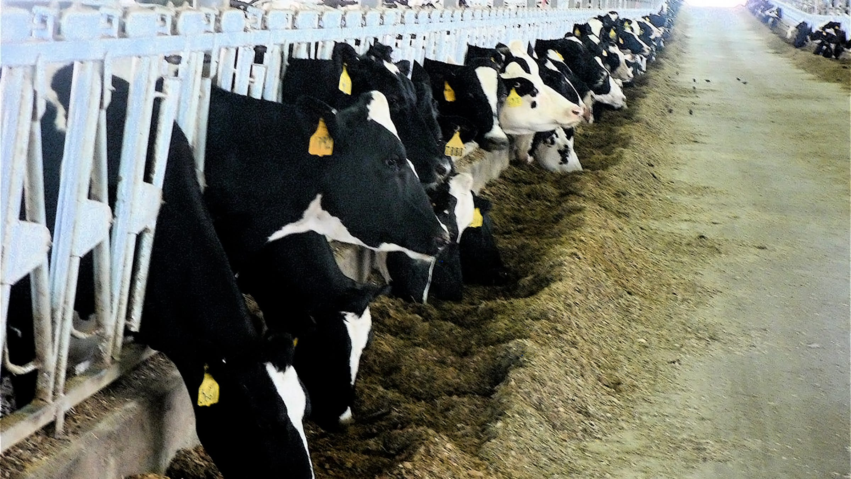
Feed is expensive
Purchased feed accounts for ~39% of the total cost of producing a hundredweight of milk (USDA, 2022)
All feed (purchased, homegrown, and grazed) totals 52% of the cost of production
Even modest reductions in feed intake can have great value
Source: Wisconsin State Farmer.

Slide 5
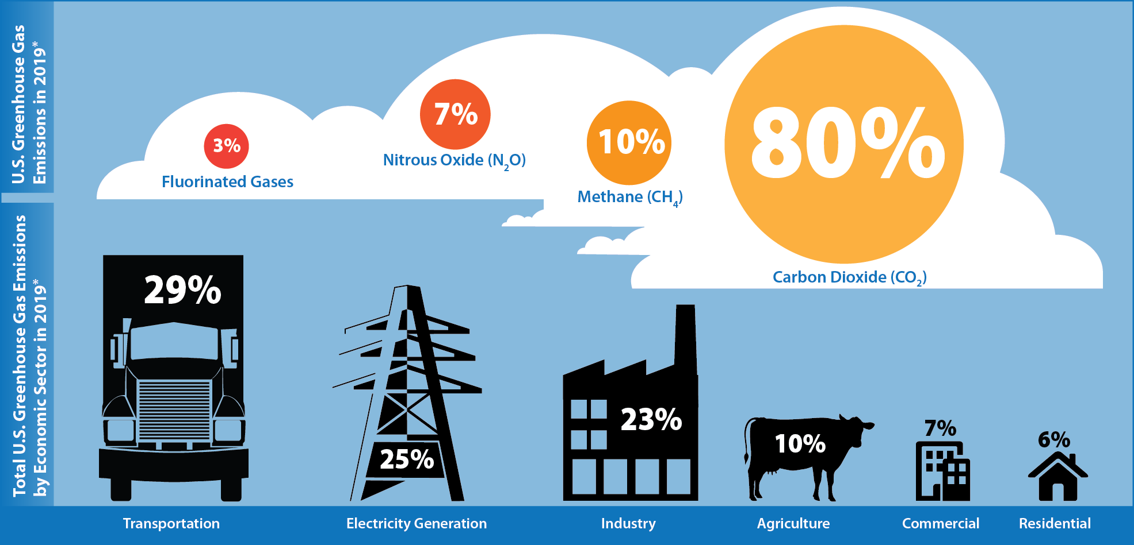
Dairy has a role to play in climate action
Source: U.S. EPA (2021; https://cfpub.epa.gov/ghgdata/inventoryexplorer/).

Slide 6
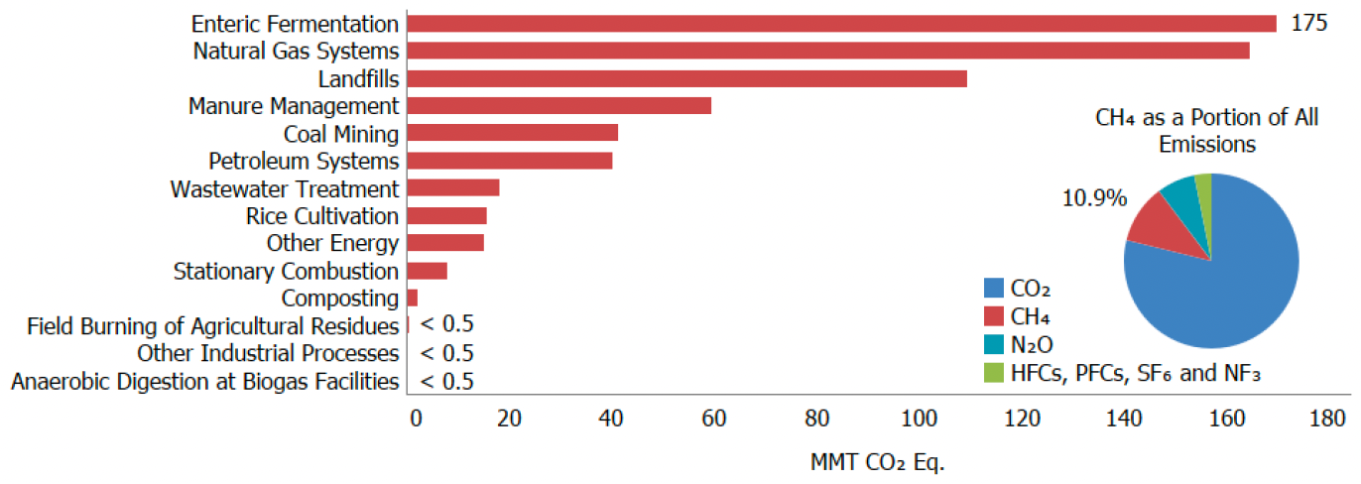
Cows make lots of methane
Source: U.S. EPA (2022; https://cfpub.epa.gov/ghgdata/inventoryexplorer/).

Slide 7
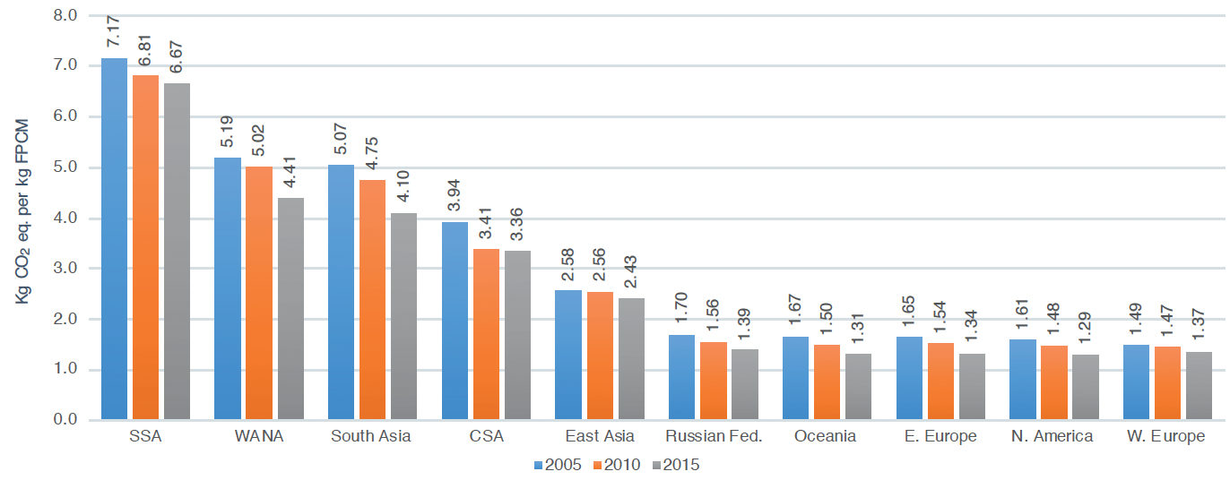
Methane emitted per kg of milk is falling
Source: FAO (2019; https://www.fao.org/3/CA2929EN/ca2929en.pdf).

Slide 8
How do we measure feed intake?

Slide 9
Early feed intake studies at USDA
Hooven et al., JDS 51:1409–1419, 1968
  661 lactations of 318 Holstein cows at Beltsville
  Genetic correlation (feed efficiency, milk energy) = 0.92
Hooven et al., JDS 55:1113–1122, 1972
  10-mo intake trials for 425 cows
  30-d trial (month 5) gave 89% of progress

Slide 10
Feed efficiency in dairy cattle (VandeHaar et al., 2016)
Units of product output per unit of product input
  Outputs: milk + meat products consumed by humans
  Inputs: lifetime feed consumed + energy, fertilizer, . . .
Biological efficiency vs. economic efficiency
  Individual cow level vs. whole farm level
Energy efficiency vs. protein efficiency
  Both important, but protein usually isn’t limiting
  Our focus is biological efficiency of energy utilization in mid lactation, relative to herdmates fed the same diet

Slide 11
Selection for feed efficiency – why now?
Before Genomics
• Measurement for 1 cow = $500
• Young bulls per year = 1,500
• Daughters per bull = 100
Cows per year = 150,000
Annual cost = $75 million
After Genomics
• Measurement for 1 cow = $500
• Cost per genomic test = $40
No. reference cows = 25,000
Young bulls per year = 5,000
One-time cost = $13.5 million
Annual update cost = $200,000
$50,000 per bull
$310 per bull
Source: Kent Weigel.

Slide 12
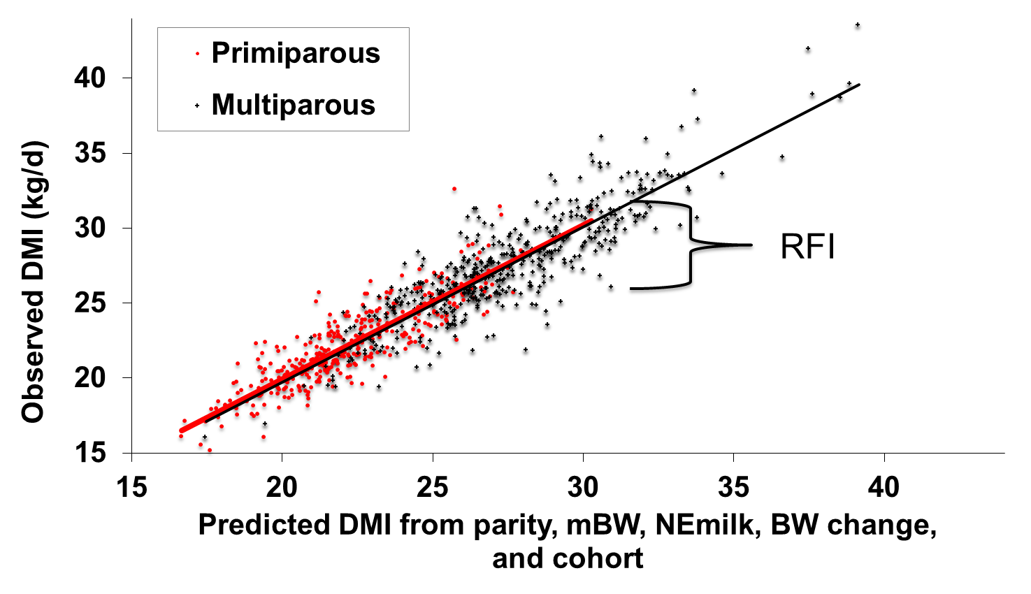
Residual feed intake (RFI)
RFI = Observed DMI - Expected DMI
Milk
Maintenance
Weight Gain/Loss
Energy Sinks
Source: VandeHaar et al. (2013).

Slide 13
When is the best time to measure RFI?
Source: Connor et al. (2019).

Slide 14
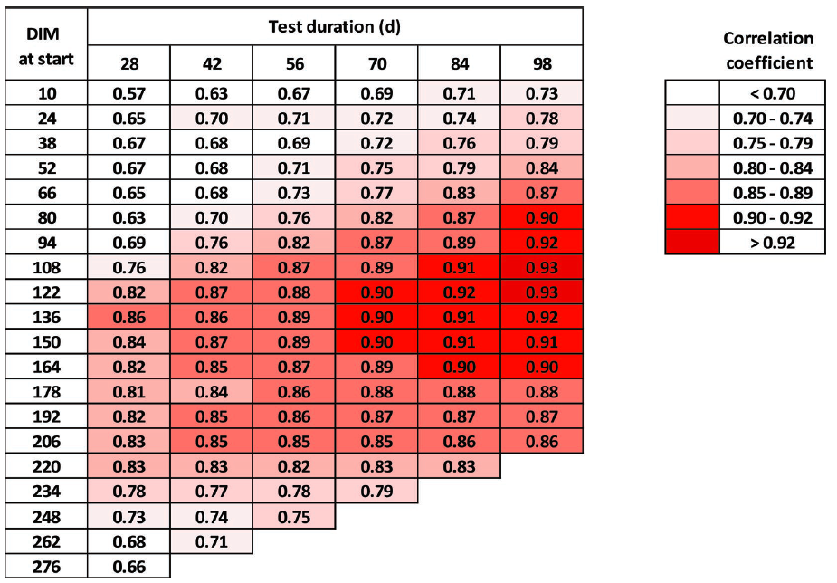
When is the best time to measure RFI?
Connor et al. (2019)

Slide 15
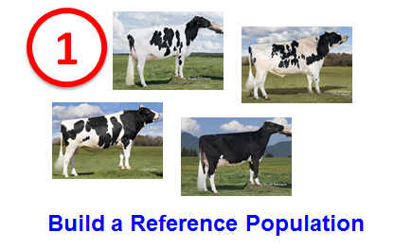
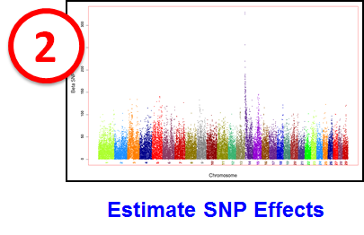
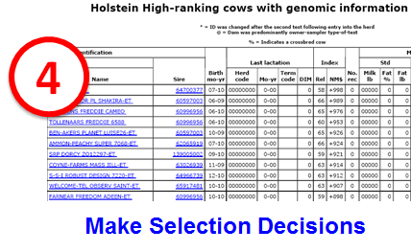
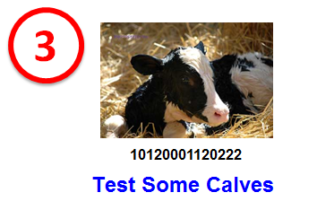
Key steps in genomic selection

Slide 16
Why is it so expensive to measure?
Source: Isa Beefmasters.

Slide 17
Is feed efficiency under genetic control?

Slide 18

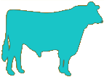
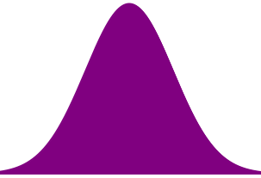
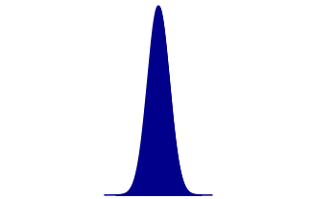
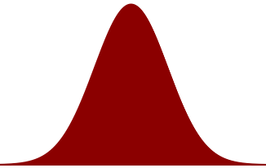
How do we know if genetics affect a trait?
Trait | Heritability (%)
Body weight | 40
Yield | 20
Somatic cell score | 12
Bull fertility | 0
One measurement has little information
Measure the performance of many daughters
=
+
Phenotypic Variation
Genetic Variation
Non-Genetic Variation

Slide 19
Sources of phenotypic variation
Fat yield (h² = 20%)
Genetics:
20 %
Environment:
80%
Somatic cell score (h² = 12%)
Genetics:
12 %
Environment:
88%
Who controls what?
Genetics:
Variance is constant
Environment:
Farmers can change this

Slide 20
What records provide the most information?
Animal group | RFI Reliability (%)
 | Traditional | Genomic¹
3,965 cows with RFI phenotypes | 30 | 34
Top 10 sires with most RFI daughters | 78 | 85
Top 100 Net Merit progeny tested sires | 8 | 16
Top 100 Net Merit young bulls | 3 | 12
1.5 million genotyped Holsteins | 5 | 13
60 million non-genotyped Holsteins | 3 | 3
¹Computed with discount factor of 0.3

Slide 21
How is our industry making use of this information?

Slide 22
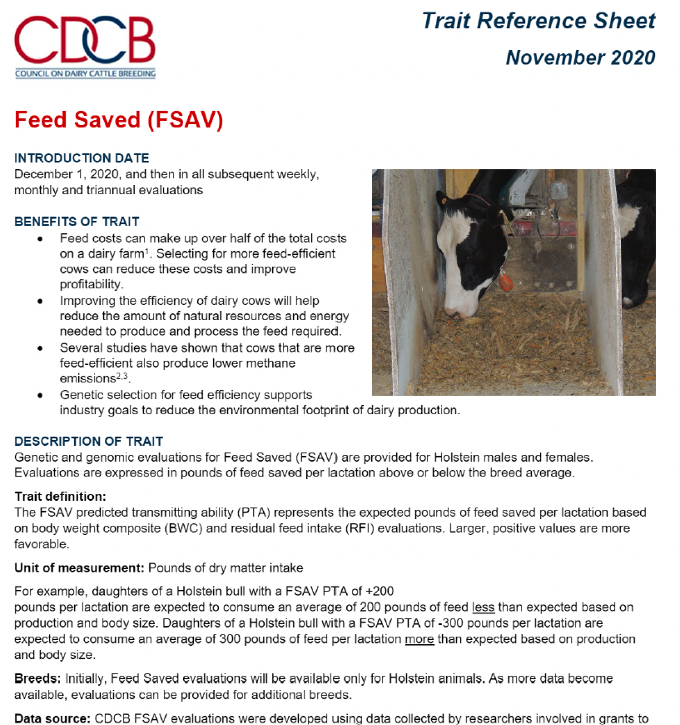
US national evaluations for feed saved
Currently based on 8,180 RFI phenotypes
Heritability
  Body Weight Composite = 40%
  Residual Feed Intake = 19%
Source: Council on Dairy Cattle Breeding (2020).

Slide 23
Feed Saved statistics – genotyped animals
Overall
Mean RFI PTA = -11.1 lb. per lactation (range -531 to 541 lb. per lactation)
Mean FSAV PTA = 39.2 lb. per lactation (range -839 to 1,046 lb. per lactation)
Proven bulls
Young bulls
Mean FSAV PTA = 34.3 lb. per lactation
Range FSAV PTA from -791 lb. to 774 lb. per lactation
Mean FSAV REL = 62%
Range FSAV REL from 39 to 96%
Mean FSAV PTA = 15.3 lb. per lactation
Range FSAV PTA from -809 lb. to 1,046 lb. per lactation
Mean FSAV REL = 46.2%
Range FSAV REL from 16 to 65%

Slide 24
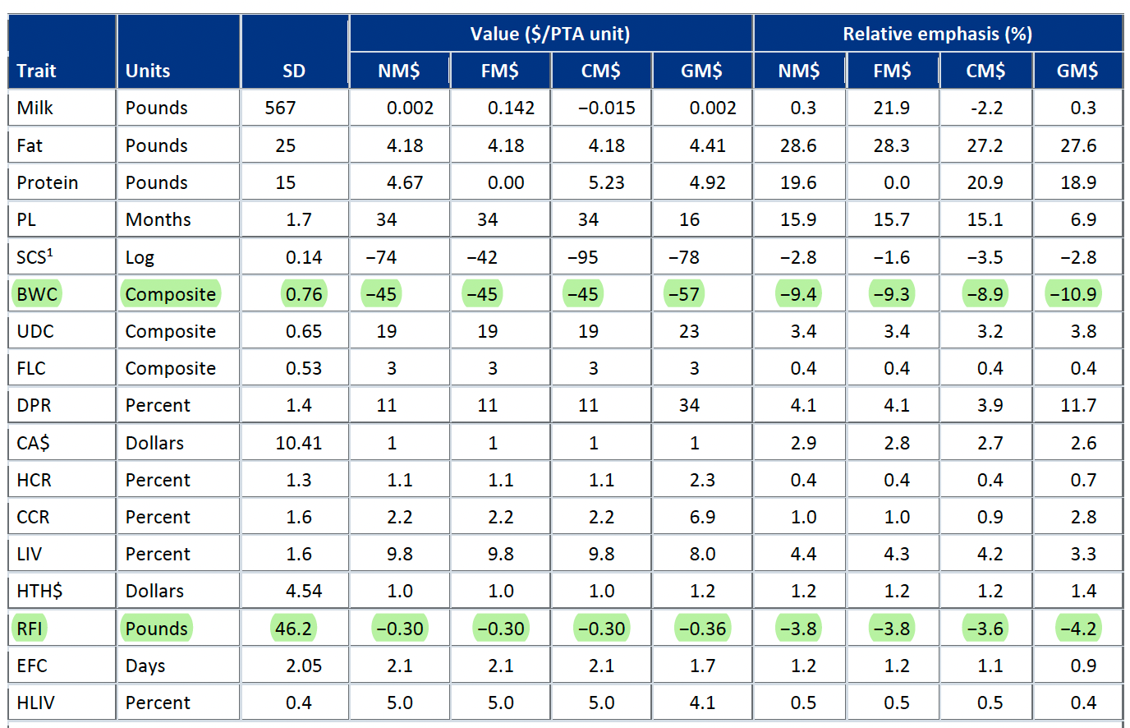
It’s part of the US national selection index
In Lifetime Net Merit, Feed Saved combines information about feed intake and body weight (15.1% of emphasis)
PTA FSAV = -1(PTA RFI) - 151.8(PTA BWC)
REL FSAV = 0.633(REL RFI) + 0.367(REL BWC)
Source: USDA-AGIL.

Slide 25


International Collaboration
Need for increasing the reference population of animals with phenotypes & genotypes
  Resilient Dairy Genome Project
CDCB Feed Saved evaluations include 1,021 additional RFI phenotypes from Canadian herds
Additional European data available and may be included in future evaluations

Slide 26

There are many variations on this theme
National evaluations
  Australia (DataGene) – Feed Saved
  Canada (Lactanet) – Feed Efficiency
  UK (AHDB) – Feed Advantage
  USA (CDCB) – Feed Saved
Breed evaluations
  Holstein USA – Total Performance Index
Proprietary evaluations
  CRV – Feed Conversion Ratio
  ST Genetics – Ecofeeed
  VikingGenetics – Saved Feed Index

Slide 27
What do 50 y of genetic progress look like?
Trait | 50-year progress | 2017 average | 2067 average | Cost of Production
Milk (pounds) | +9,329 | 27,055 | 36,384 | 50/cwt?
Fat (pounds) | +531 | 1,008 | 1,539
Protein (pounds) | +342 | 825 | 1,167
Productive life (months) | +65 | 26 | 91
Body size (pounds) | –230 | 1,500 | 1,230
Udder composite | +2.65 | 0 | 2.65
Daughter pregnancy rate (%) | +26 | 29 | 55
Cow conception rate (%) | +42 | 35 | 77
Heifer conception rate (%) | +21 | 57 | 78
Residual feed intake (pounds) | -11,150
Methane intensity (%) | -24-24

Slide 28
What’s likely to change in the future?

Slide 29
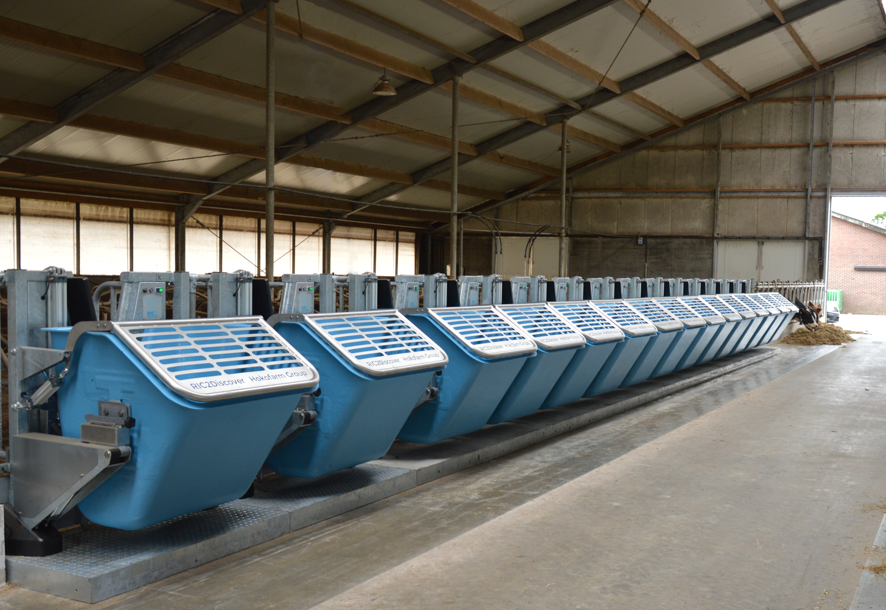
Data collection costs are high
Bin-based systems are the gold-standard for measuring individual feed intake
Equipment costs are fairly high, and only two cows can share a bin
Several vendors provide these types of systems (C-Lock, BioControl, Hokofarm, Intergado, Vytelle)
Source: Hokofarm Group

Slide 30
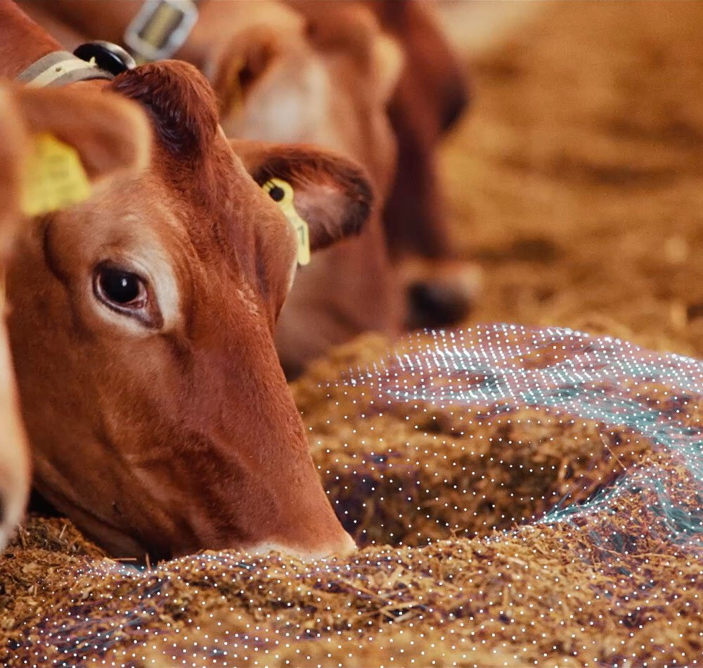
Opportunities for lower-cost recording
Camera-based computer vision systems (e.g., Borcherson et al., 2018)
Mid-infrared milk spectral data (e.g., Shadpour et al., 2022)
On-cow sensors (e.g., Ding et al., 2022)
Correlated traits?
Source: Viking Genetics

Slide 31
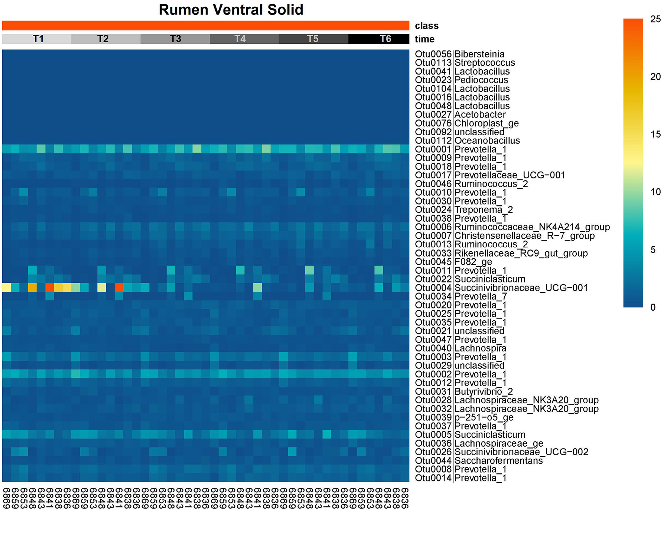
What about the microbiome?
Also has high cost of data collection (fistulation, intubation, etc.)
Representative samples can be obtained at scale by buccal swabbing (Young et al., 2020)
There are associations of microbiome profiles with feed efficiency (e.g., Zhang et al., 2022)
Source: Young et al. (2022).

Slide 32
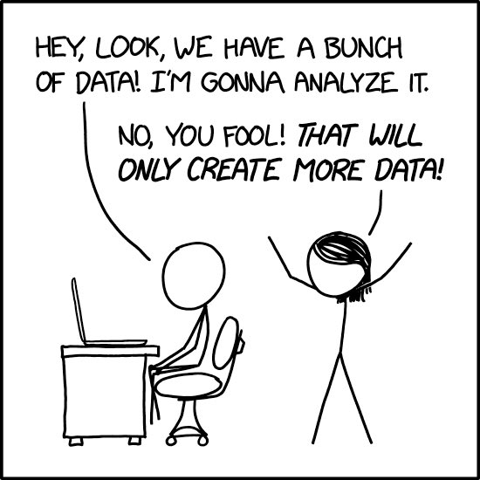
Source: https://xkcd.com/2582.

Slide 33
Take-home message…

Slide 34
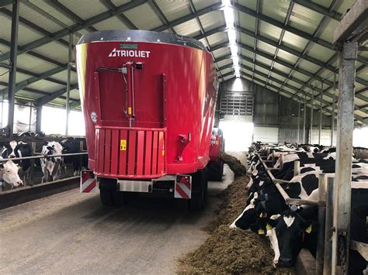
Continuous improvement is the key!
Genetic selection provides continuous, permanent improvement over time
The cost of data collection limits the reliability of the resulting PTA
Correlated traits that can be collected at low cost will improve the efficiency of selection programs
Source: Young et al. (2022).
Source: Trioliet.

Slide 35


Conclusions
The world around us is changing so we need to change, too
The cow of the future will need to do more with less
We have very powerful tools for creating those cows
Social license will become even more important
Questions?

Slide 36
References
Berry, D.P. et al. 2014. International genetic evaluations for feed intake in dairy cattle through the collation of data from multiple sources. J. Dairy Sci. 97:3894-3905. https://doi.org/10.3168/jds.2013-7548.
Borchersen, S. et al. 2018. System for determining feed consumption of at least one animal. U.S. Patent No. 9,861,081. Washington, DC: U.S. Patent and Trademark Office.
Connor, E.E. et al. 2019. Determining the optimal period length and stage of growth or lactation to estimate residual feed intake in dairy cows. J. Dairy Sci. 102:6131–6143. https://doi.org/10.3168/jds.2018-15407.
Council on Dairy Cattle Breeding. 2020. Feed Saved (FSAV) Trait Reference Sheet. https://www.uscdcb.com/wp-content/uploads/2020/11/CDCB-Reference-Sheet-Feed-Saved-12_2020.pdf.
Ding, Luyu et al. 2022. Predicting the feed intake of cattle based on jaw movement using a triaxial accelerometer. MDPI Agriculture. 12:899. https://doi.org/10.3390/agriculture12070899.

Slide 37
References (cont’d)
Shadpour, Saeed et al. 2022. Predicting dry matter intake in Canadian Holstein dairy cattle using milk mid-infrared reflectance spectroscopy and other commonly available predictors via artificial neural networks. J. Dairy Sci. 105:8257–8271. https://doi.org/10.3168/jds.2021-21297.
United Stated Department of Agriculture. 2022. Milk Cost of Production Estimates: Recent Milk Cost of Production Estimates-2016 Base (By State). https://www.ers.usda.gov/webdocs/DataFiles/52180/MilkStates2016%20base.xlsx?v=3274.6.
VandeHaar, M.J. et al. 2016. Harnessing the genetics of the modern dairy cow to continue improvements in feed efficiency. J. Dairy Sci. 99:4941-4954. https://doi.org/10.3168/jds.2015-10352.
Young, J. et al. 2020. Validating the use of bovine buccal sampling as a proxy for the rumen microbiota using a time course and random forest classification approach. Appl. Environ. Microbiol. 86:e00861-20. https://doi.org/10.1128/AEM.00861-20.

Slide 38
References (cont’d)
Zhang et al. 2022. Association of residual feed intake with peripartal ruminal microbiome and milk fatty acid composition during early lactation in Holstein dairy cows. J. Dairy Sci. 105:4971–4986. https://doi.org/10.3168/jds.2021-21454.

